Slide 1
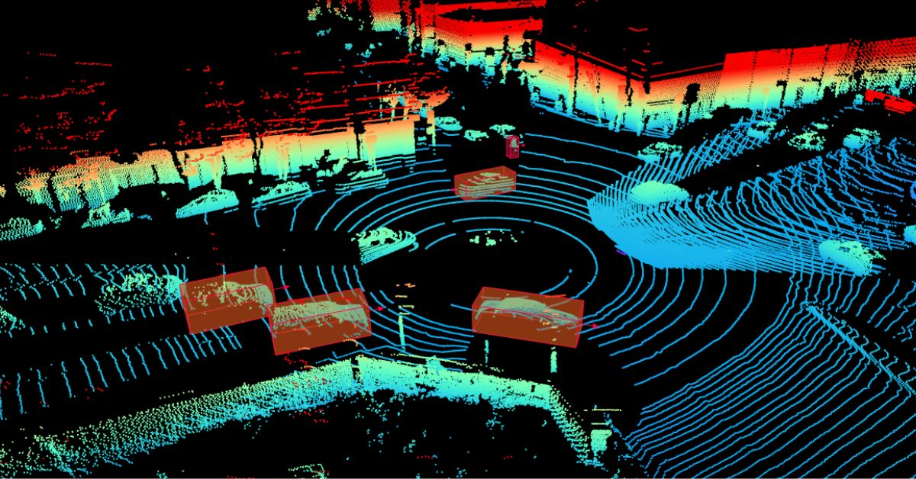

3D Point Cloud Processing

Slide 2
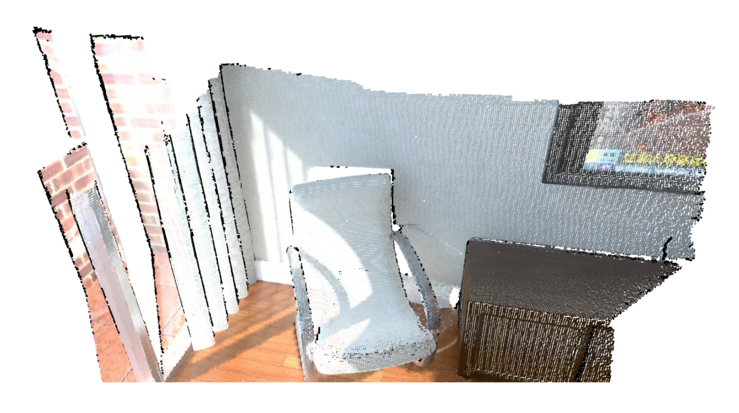
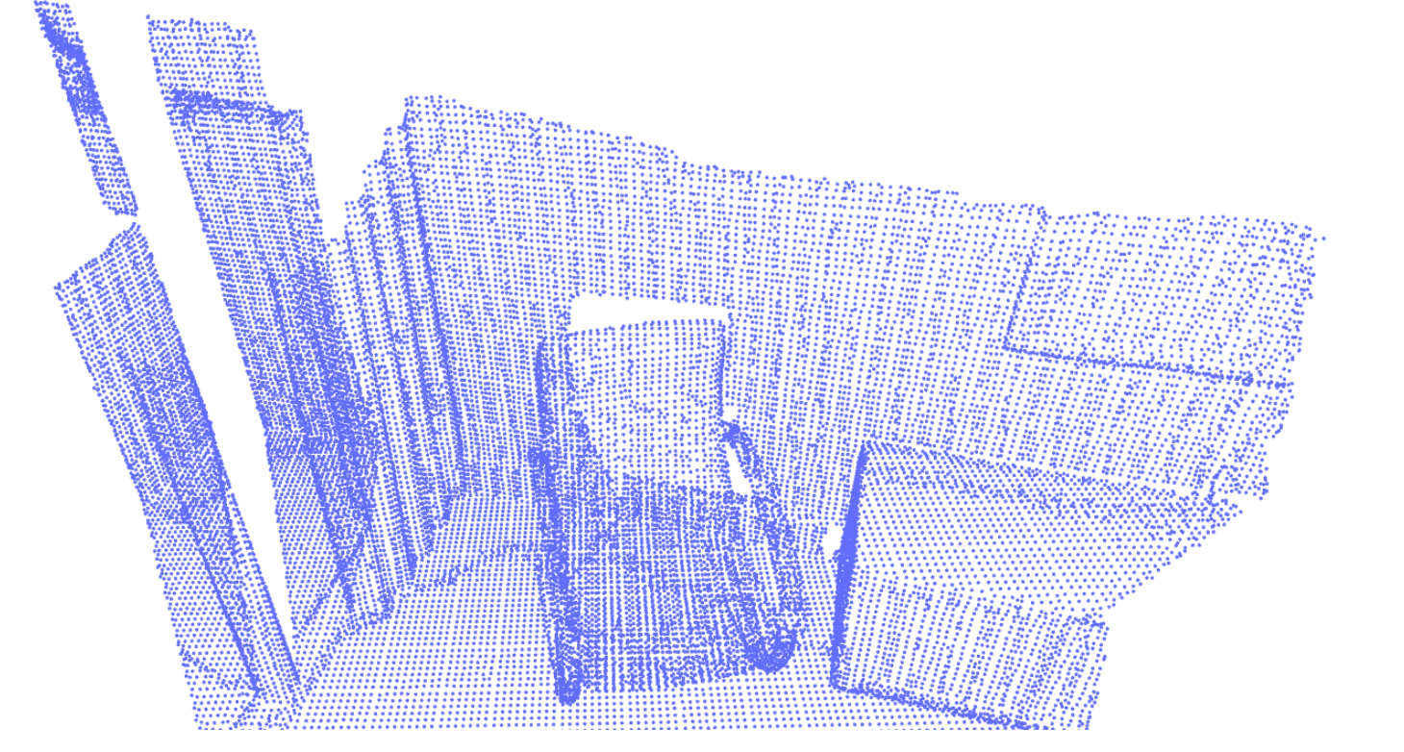
What is Voxel downsampling?
Voxel downsampling is a technique used in point cloud processing to reduce the number of points in a point cloud while preserving the underlying structure and features of the original data.

Slide 3
What is Voxel downsampling?
It involves dividing the 3D space occupied by the point cloud into small voxels, or 3D cubes, and keeping only one point from each voxel. The point selected from each voxel is typically the centroid or the closest point to the center of the voxel.

Slide 4
Why downsample?
To reduce the size of a point cloud to speed up subsequent processing, such as registration, segmentation, or classification, while maintaining a good representation of the original data.
Helps to remove noise and outliers, as points that do not have enough neighbors in their voxel can be discarded.
Uniform Sampling: Downsampling can ensure a uniform distribution of points across the 3D space, which is often important for algorithms that assume an even point density.

Slide 5
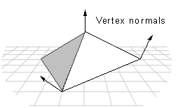
Vertex Normal Estimation
The process of estimating surface normals for each vertex of a 3D mesh or point cloud.
Surface normals are vectors that are perpendicular to the surface of an object and are useful in various applications, such as shading and collision detection.

Slide 6
Vertex Normal Estimation
In mesh processing, vertex normal estimation is important for calculating smooth shading of surfaces.
When a mesh is rendered, the appearance of the surface depends on the angle between the surface normal and the light source.
Smooth shading requires that the normals of neighboring triangles are aligned, so the surface appears continuous and smooth.

Slide 7
Vertex Normal Estimation
If the normals of neighboring triangles are not aligned, the surface will not appear smooth or continuous.
Each triangle will reflect light independently, causing the surface to appear as a collection of discrete, flat facets rather than a smooth surface.
This effect is often referred to as flat shading

Slide 8
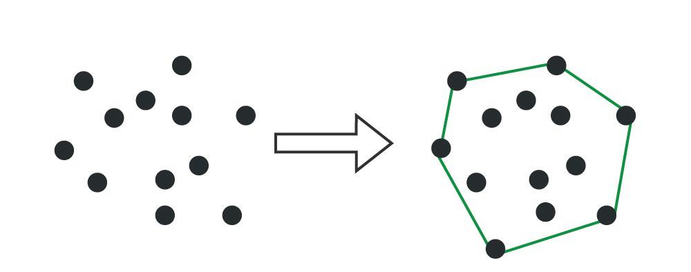
Convex Hull
The convex hull of a set of points in a Euclidean space is the smallest convex polygon that encloses all of the points.
In two dimensions (2D), the convex hull is a convex polygon, and in three dimensions (3D), it is a convex polyhedron.

Slide 9
Why Convex Hull?
The convex hull provides a minimal, compact representation of the outer boundary of a point cloud
It reduces the complexity of computations by focusing only on the boundary points, ignoring the interior points.
In robotics, the convex hull is used to approximate complex shapes for efficient collision detection.
Convex hull helps compute properties like volume, surface area, and centroid for irregular or scattered data points.

